Slide 1
DDCA|Computer Science
8-Bit Signed Binary Number Representation Using Two’s Complement
DESIGN AND SIMULATION IN LOGISIM

Slide 2




PRESENTED BY:
Madhu priya-2620080072
Jeyanth vighnesh-2620080063
Venkata ramana-2620080054
Juhitha-2620080124

Slide 3
Problem Statement
Design an 8-bit binary circuit in Logisim
Represent positive and negative numbers.
Perform addition and subtraction.
Use Two’s Complement for subtraction.

Slide 4
Design / Methodology
Addition
Two 8-bit numbers are given as input.
Full Adders are used for addition.
Invert the second number using NOT gates.
Add 1 to get Two’s Complement.
Add it to the first number.
Subtraction
A − B = A + 2’s Complement of B

Slide 5

Range of 8- bit Signed Numbers
Minimum = -128
Maximum = +127
Sign value
0 ⟶ positive
1 ⟶ negative

Slide 6
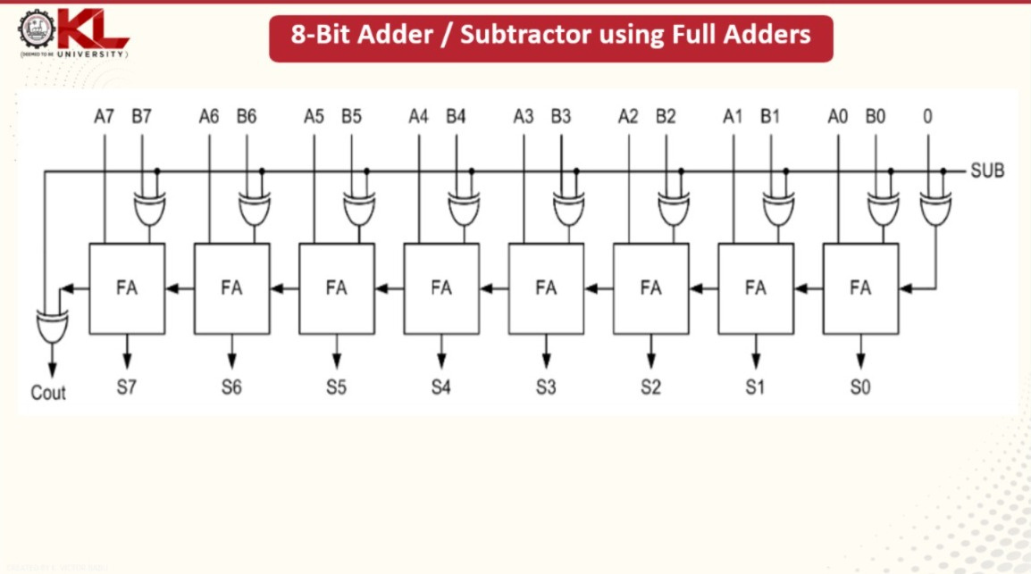
Demo in Logisim
A=
0 | 0 | 0 | 0 | 0 | 1 | 0 | 1
B=
0 | 0 | 0 | 0 | 0 | 1 | 0 | 1
Result =
0 | 0 | 0 |  | 0 | 0 | 0 | 1 | 1
8-5=3

Slide 7
Github repository
https://github.com/neerudimadhupriya-cmyk

